Slide 1
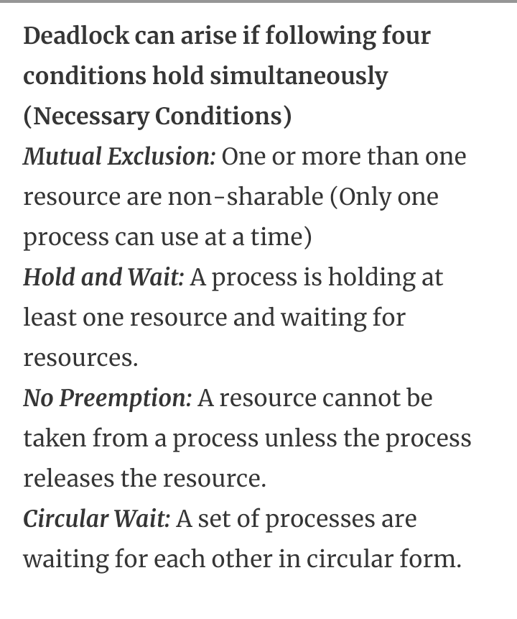
Operating System BCA-IV SEM
Conditions for deadlocks:

Slide 2
2

Slide 3
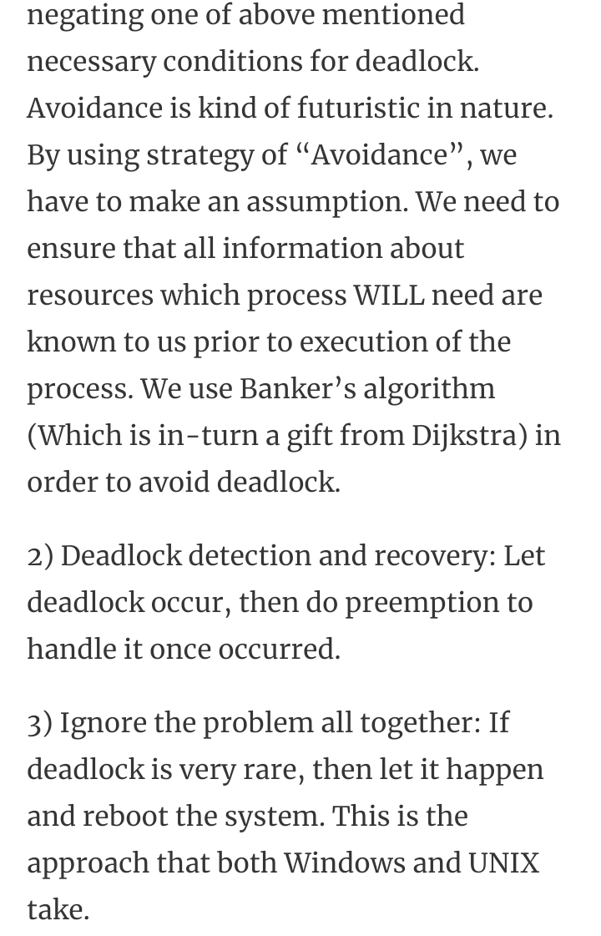
3

