Slide 1
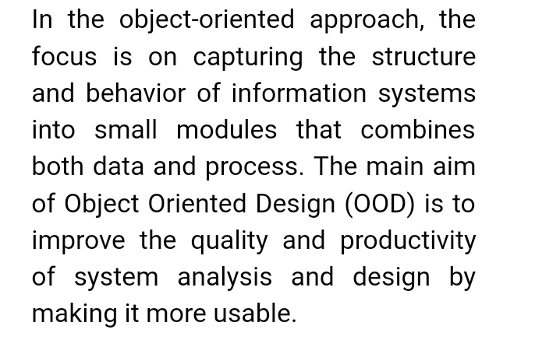
DPBS PG COLLEGE ANOOPSHAHR Subject: Information System
Design & implementation on OO platform :

Slide 2
2

Slide 3
3

