Slide 1
Digital Electronics and Computer organization BCA-II SEM Topic: Sequential Circuits (latches and flip-flops)

Slide 2
2

Slide 3
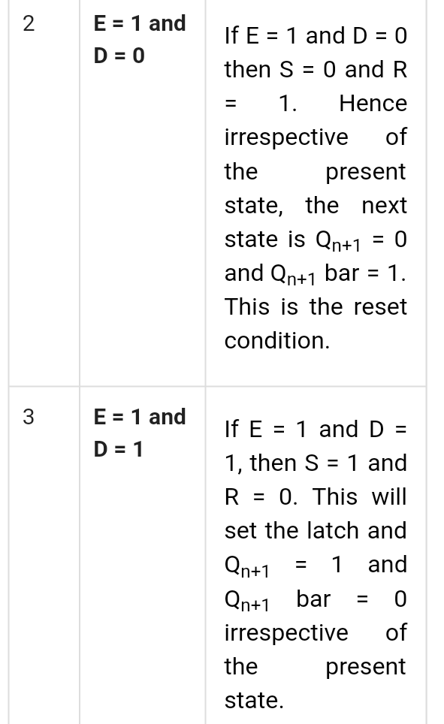
3

