Slide 1
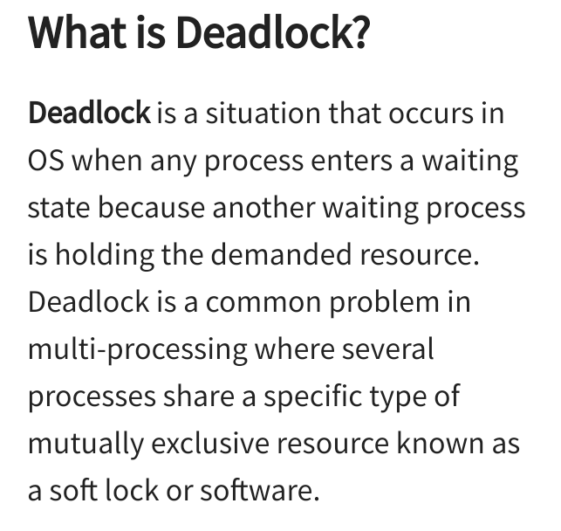
Operating System BCA-IV SEM
Deadlocks:

Slide 2
2

Slide 3
3

Slide 4
4

