Slide 1
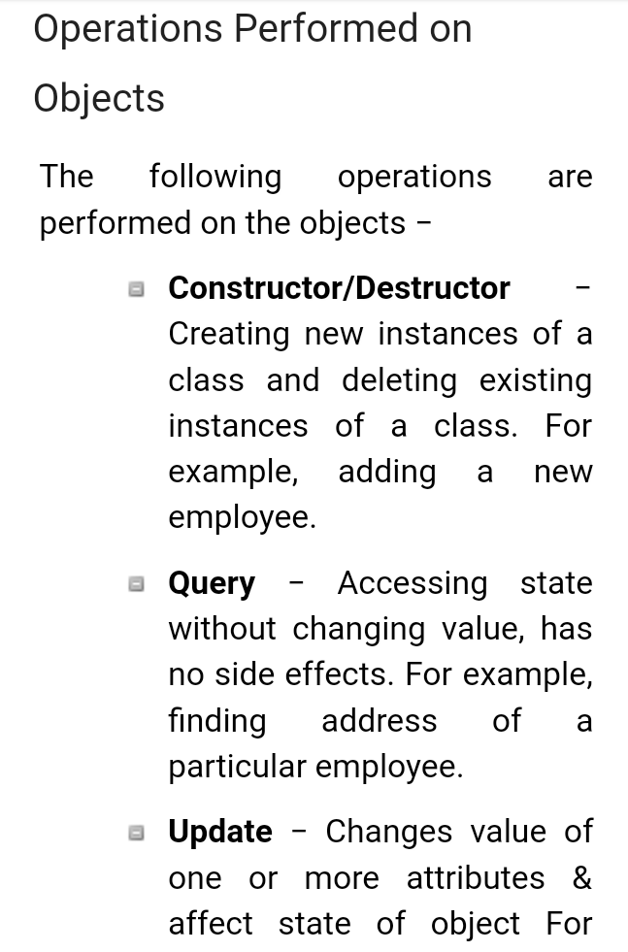
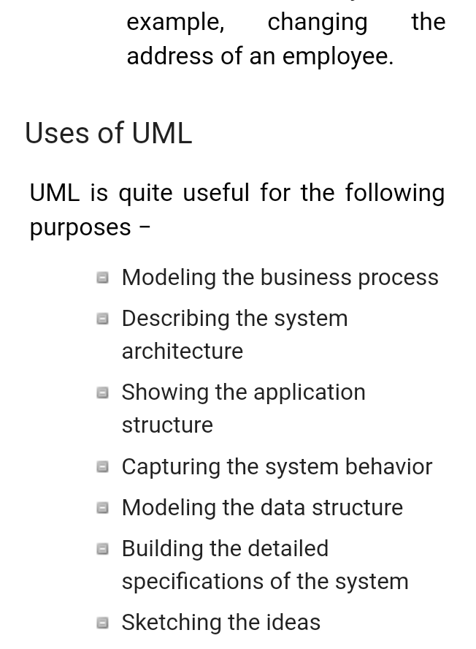
Information System BCA –VI DESIGN AND IMLEMENTATION ON OO PLATFORM

Slide 2
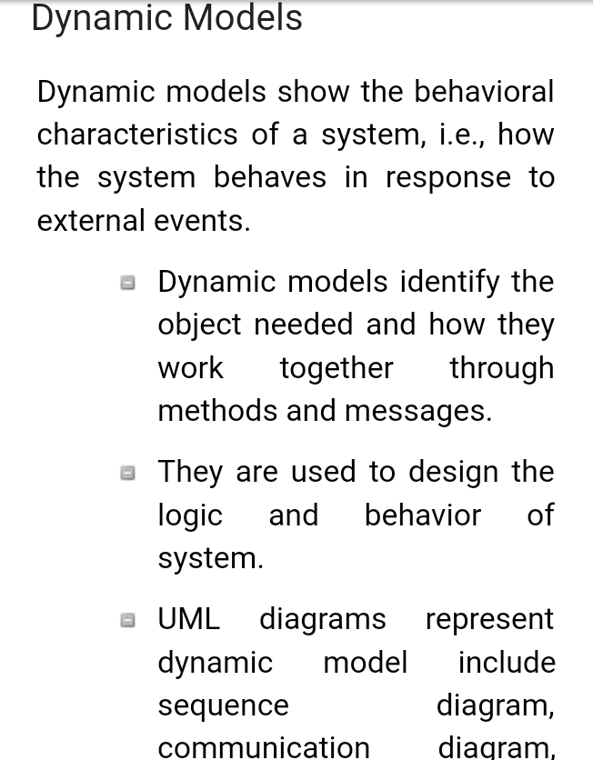
2
S P GAUTAM
MODELS:

