Slide 1
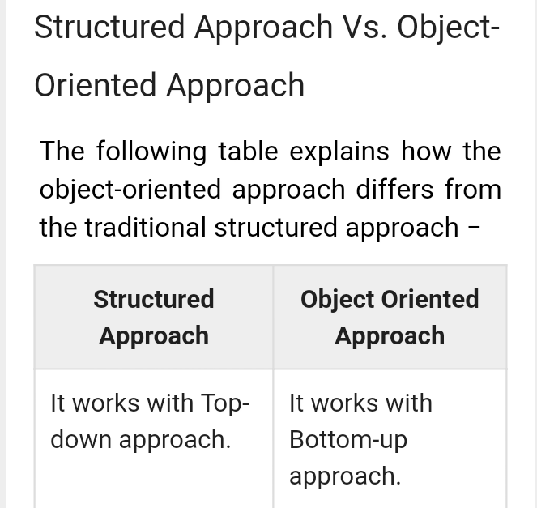
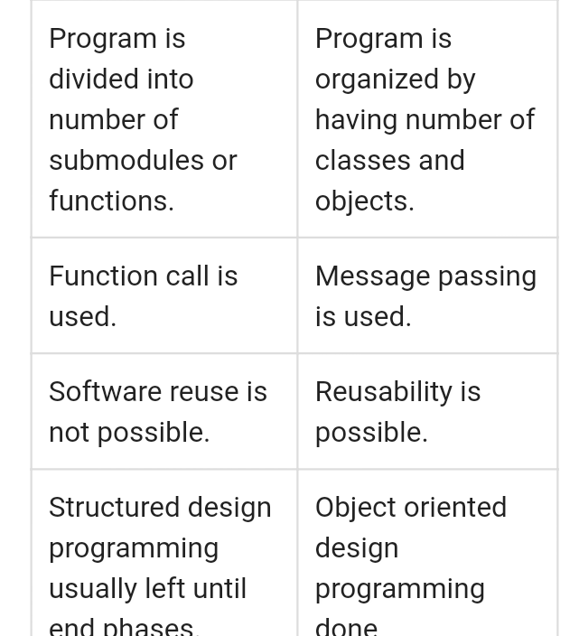
Information System BCA –VI DESIGN AND IMLEMENTATION ON OO PLATFORM

Slide 2
2
S P GAUTAM

Slide 3
3

