Slide 1
Information System BCA –VI DESIGN AND IMLEMENTATION ON OO PLATFORM
.

Slide 2
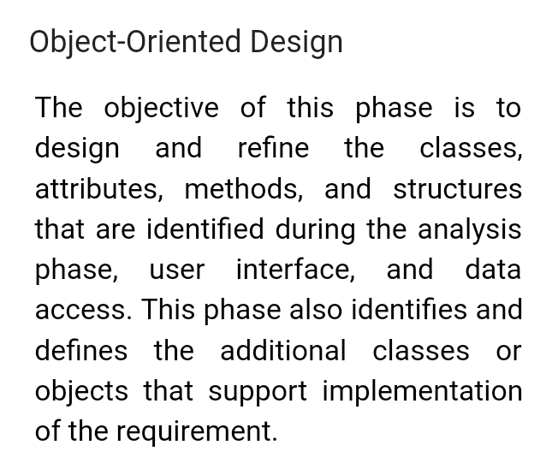
2

