Slide 1
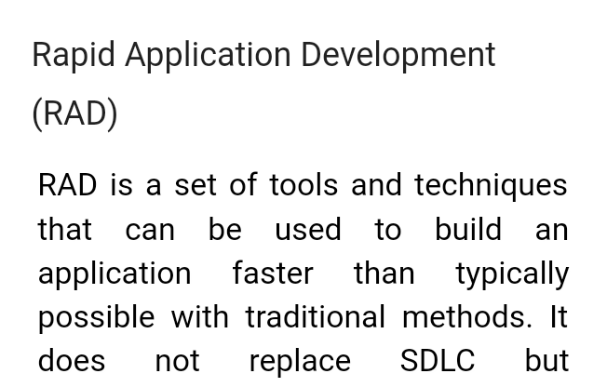
Information System BCA –VI DESIGN AND IMLEMENTATION ON OO PLATFORM

Slide 2
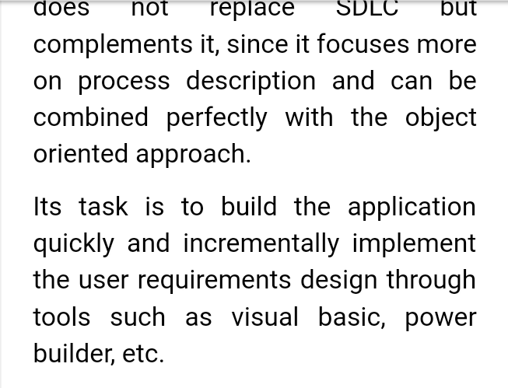
2

