Slide 1
Information system BCA-VI topic: Design and Implementation on OO platform

Slide 2
2

Slide 3
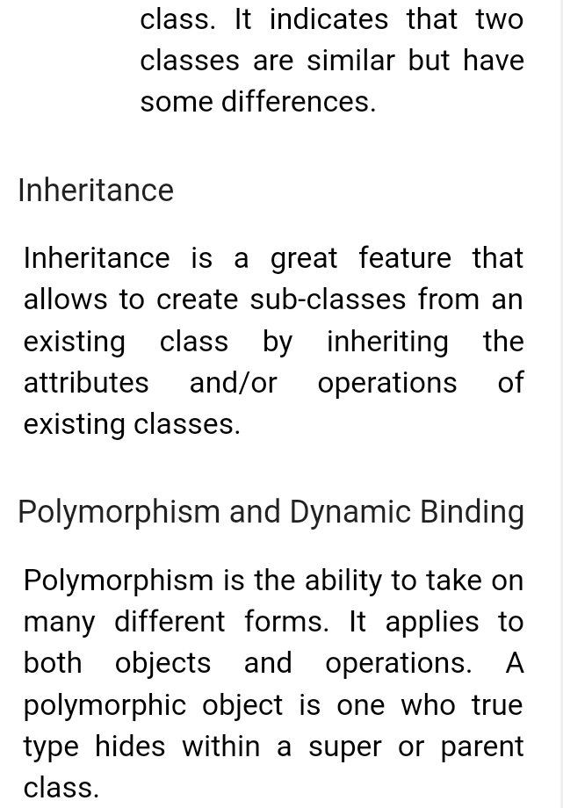
3

