Slide 1
DPBS PG COLLEGE ANOOPSHAHR
Digital Electronics and Computer organization
S P GAUTAM Topic: Sequential Circuits BCA-II SEM
Sub topic: latches and flip-flops
latche :- (hold,lock) latch are the basic blocks using which flip-flop are constructed.
Latch have capability to store one bit.
latch have not clock pulse.
NOT GATE
Input X 0 Q
input y 1 Q’
NOT GATE
actualy Q work as input and output .
If Qn is input then output will be Qn+1 .
Qn Qn+1
i/p o/p
If Q is 0 then Q’ will be 1
And Qn -> Qn+1

Slide 2
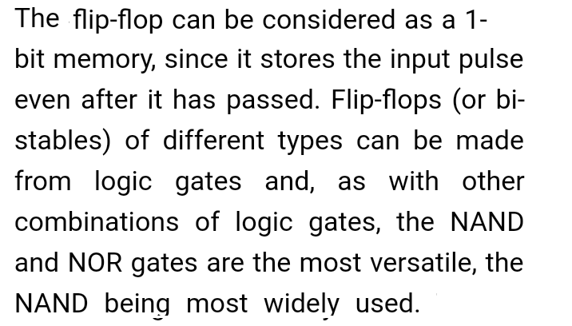
Flip-flop
S P GAUTAM

Slide 3
FLIP-FLOP
S P GAUTAM
Capable of storing 1-bit
Bi-stable device
Functionality type(RS ,JK,T,D)
Operation mode(latch, transparent)
Clock synchronization(+ve level,+-ve edge)
Construction (NOR,NAND) Qn
I/P
Ǭn
f f
Basic diagram

