Slide 1
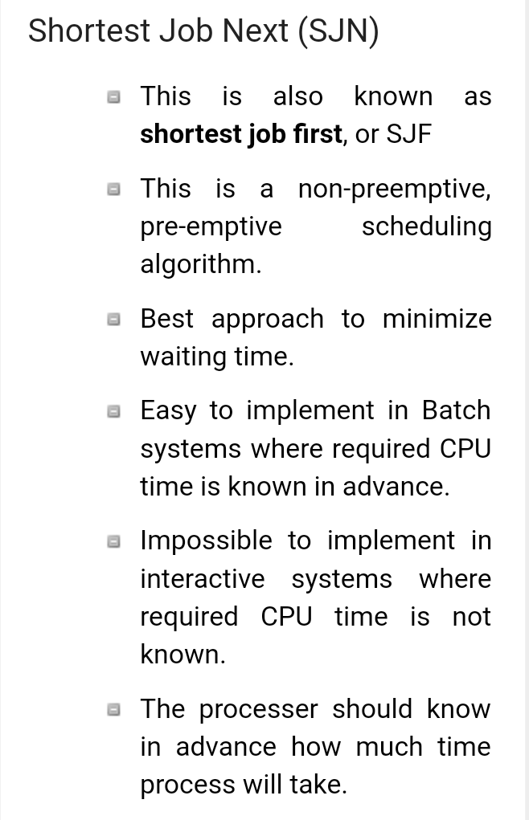
Operating System BCA-IV SEM Scheduling Algorithms

Slide 2
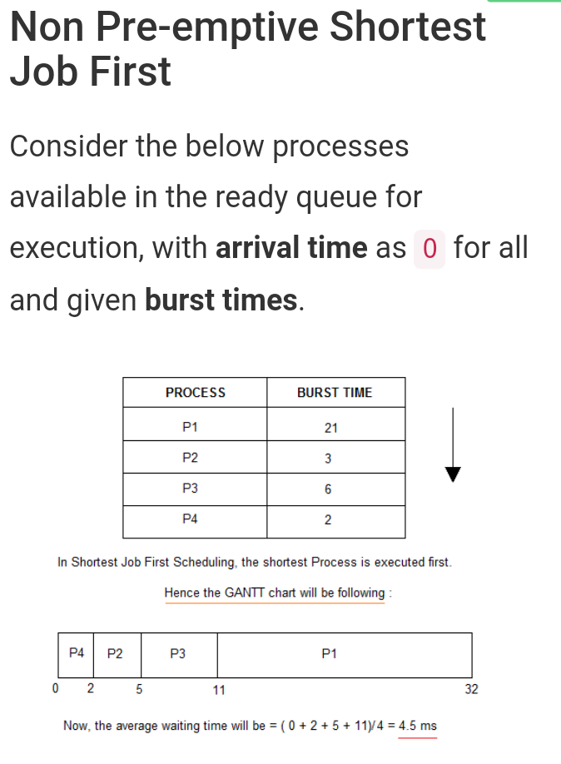
2

Slide 3
3

