Slide 1
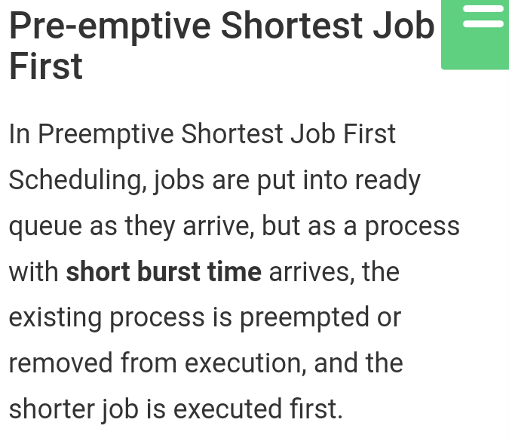
Operating System BCA-IV SEM Scheduling Algorithms

Slide 2
Preemptive shortest job first:

Slide 3
3

Slide 4
4

