Slide 1
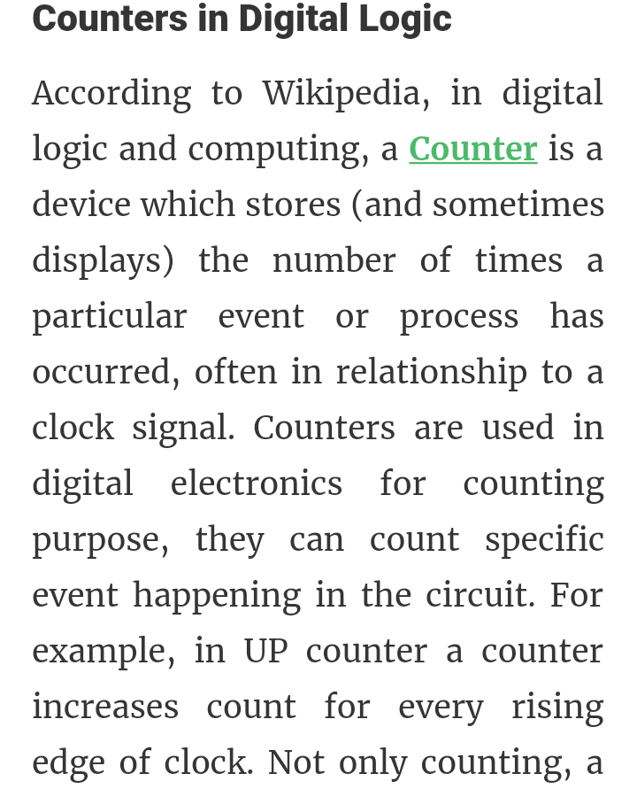
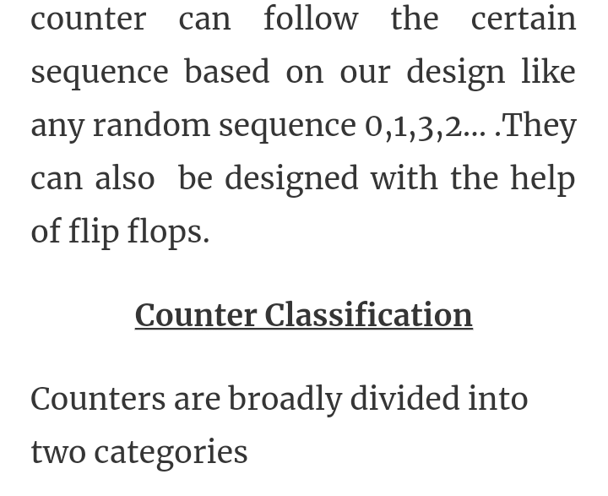
Digital Electronics and Computer organization BCA-II SEM Topic: Sequential Circuits
Counters:

Slide 2
2

Slide 3
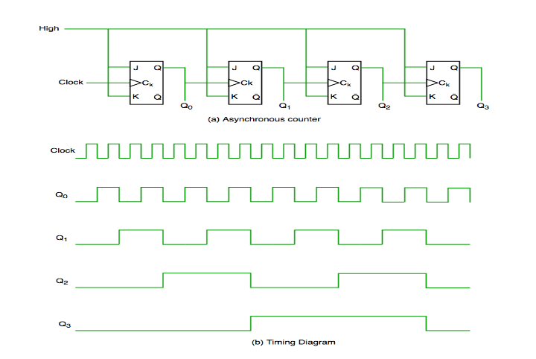
3

Slide 4
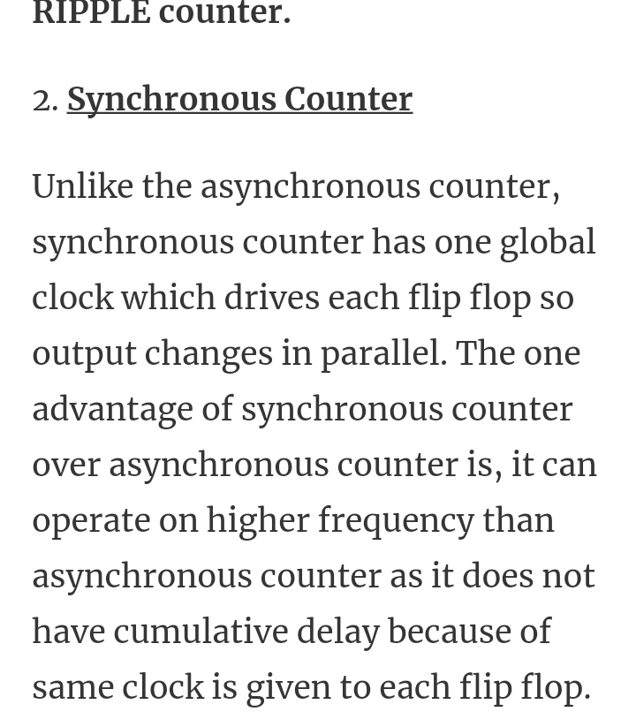
4

Slide 5
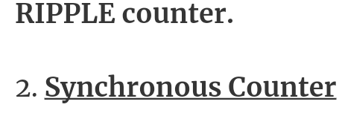
5

Slide 6
6

Slide 7
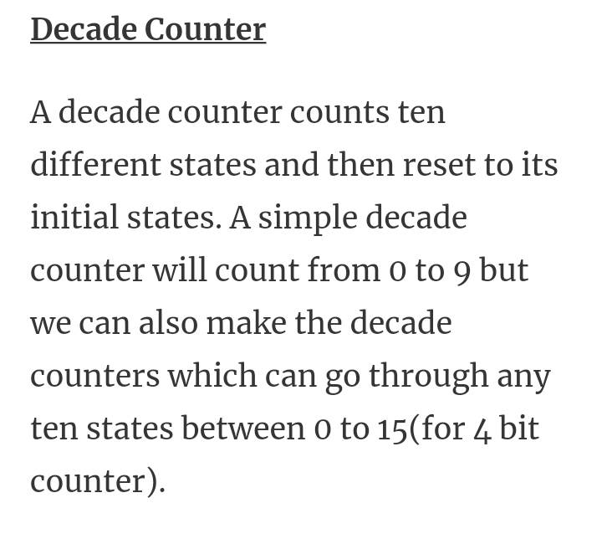
7

Slide 8
8

Slide 9
9

