Slide 1
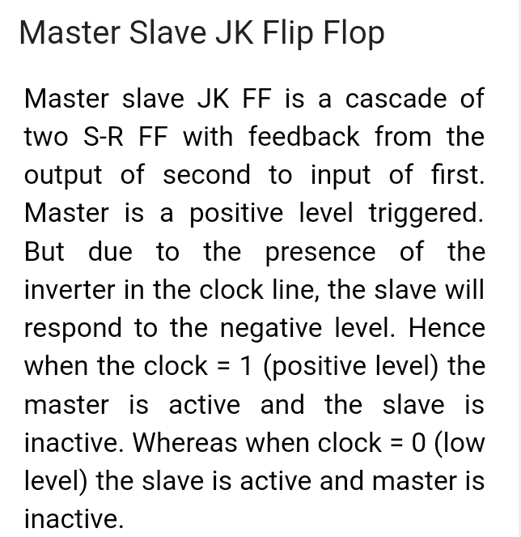
Digital Electronics and Computer organization BCA-II SEM Topic: Sequential Circuits (latches and flip-flops)

Slide 2
2

Slide 3
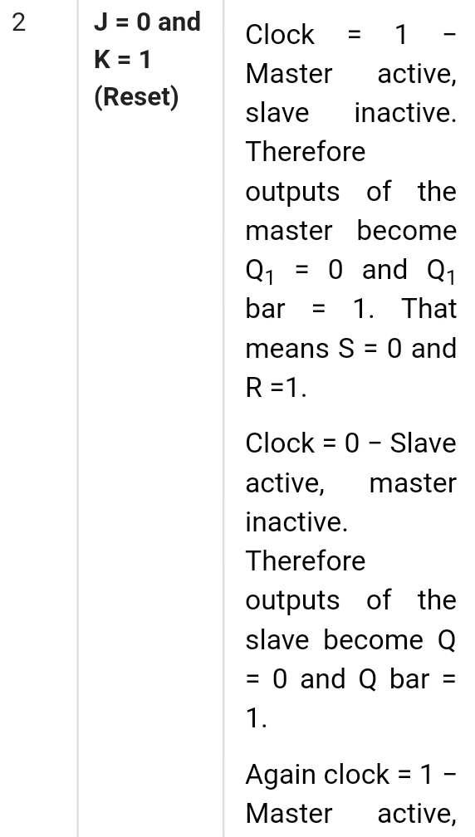
3

Slide 4
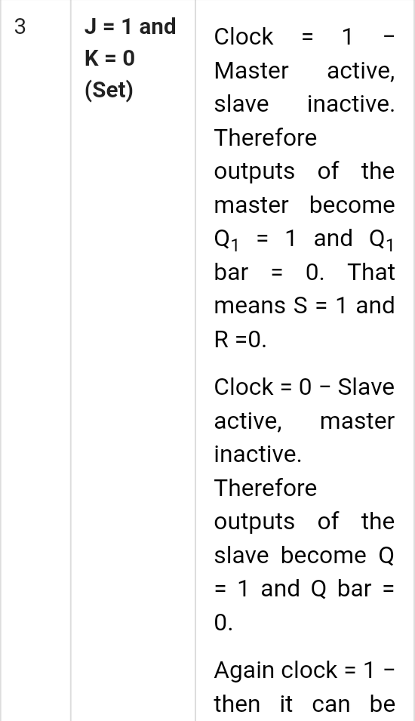
4

Slide 5
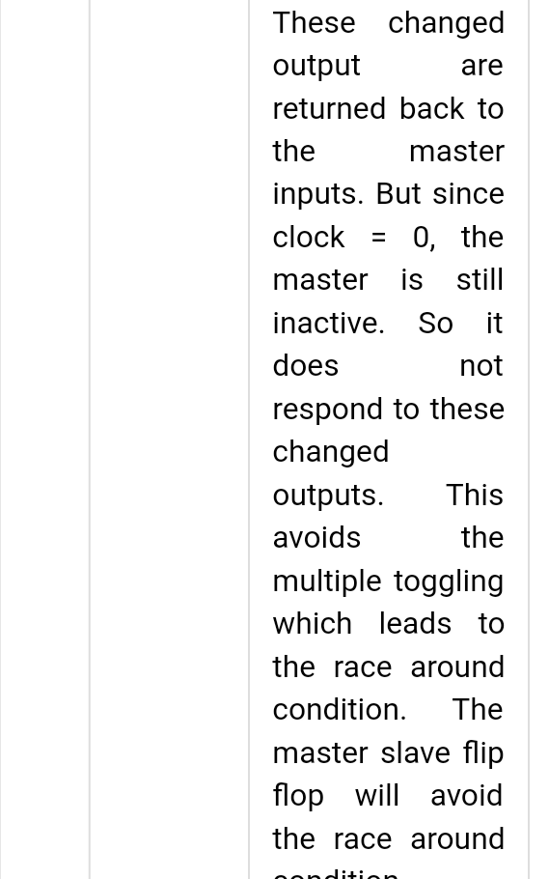
5

