Slide 1
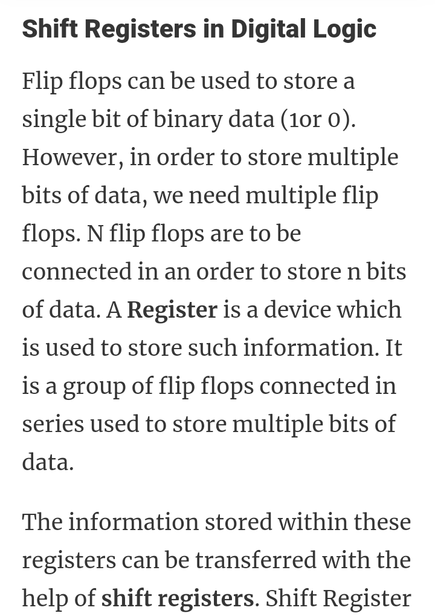
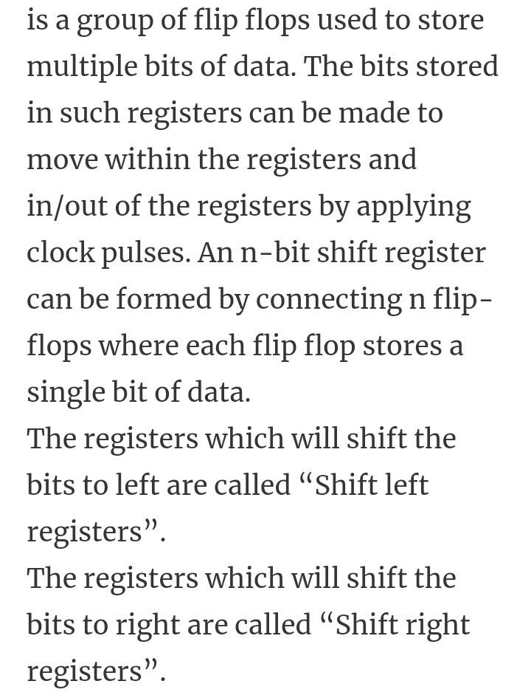
Digital Electronics and Computer organization BCA-II SEM Topic: Sequential Circuits
Resister and Sift Resister:

Slide 2
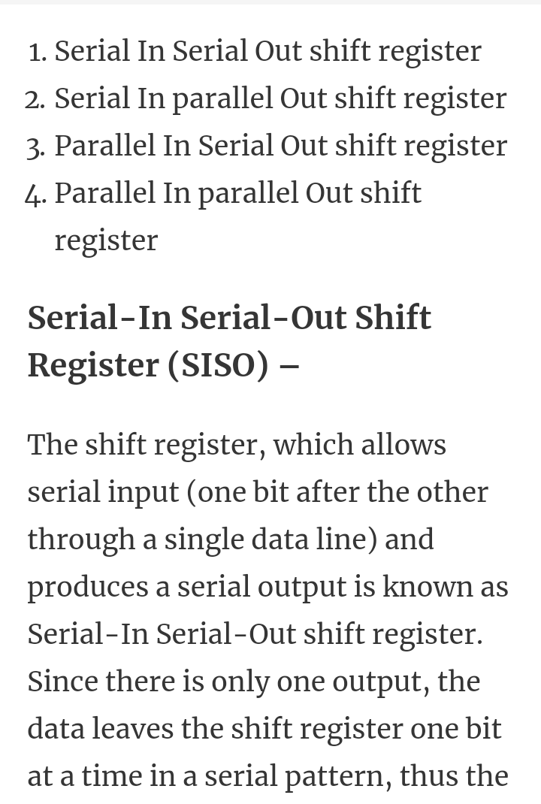
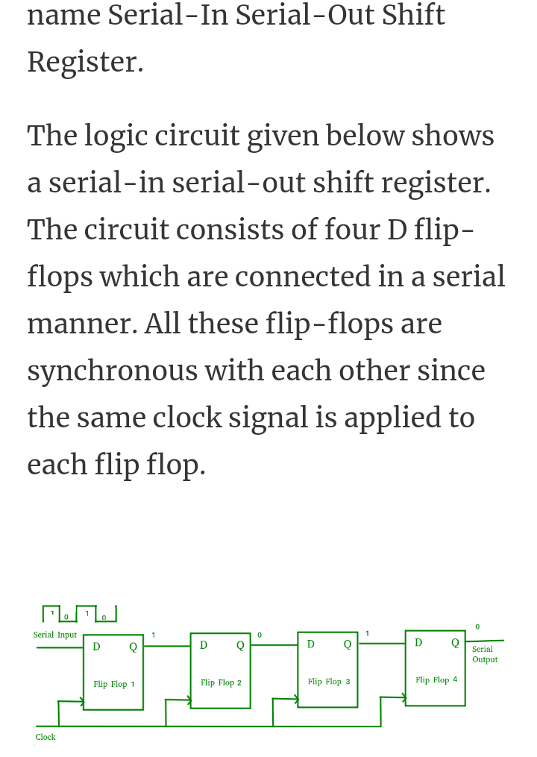
2

Slide 3
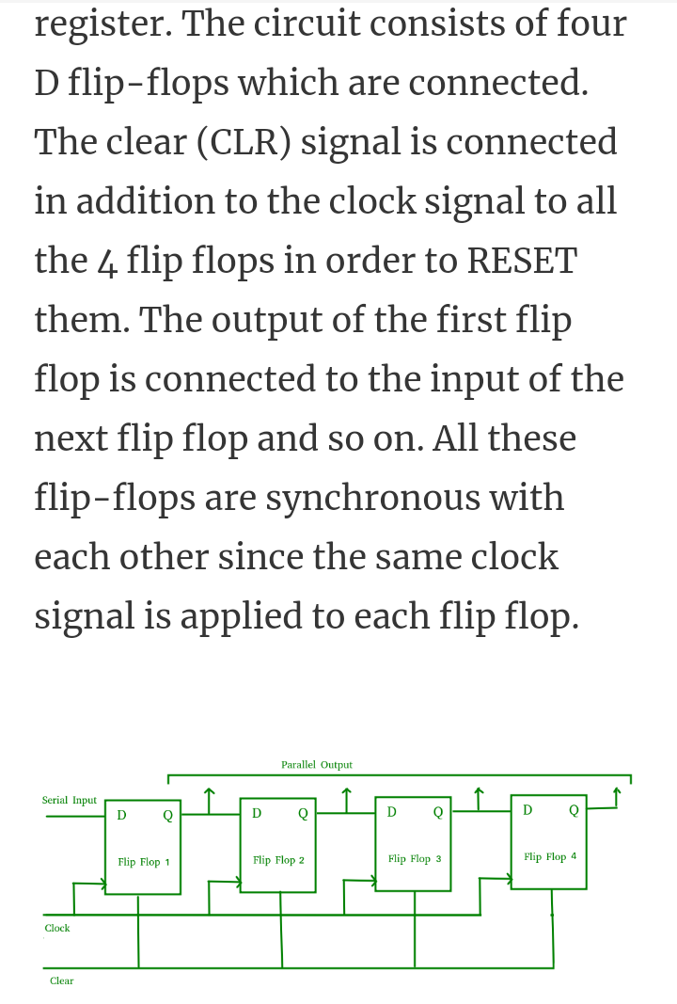
3

Slide 4
4

Slide 5
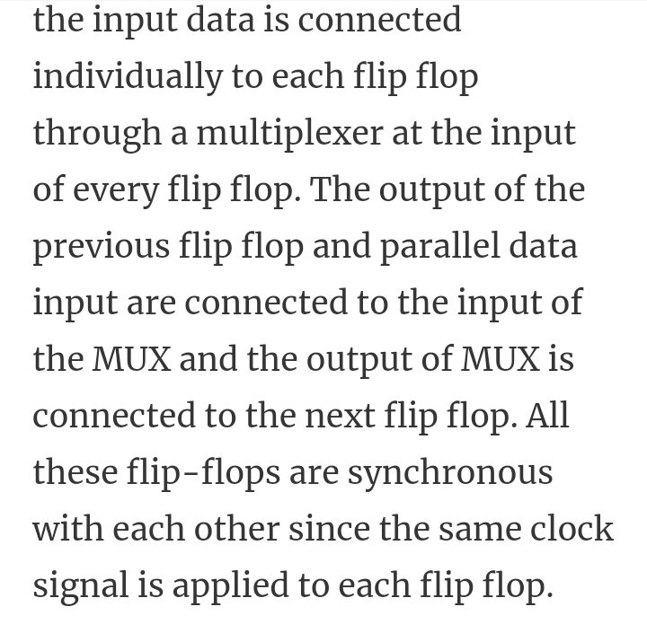
5

Slide 6
6

