Slide 1
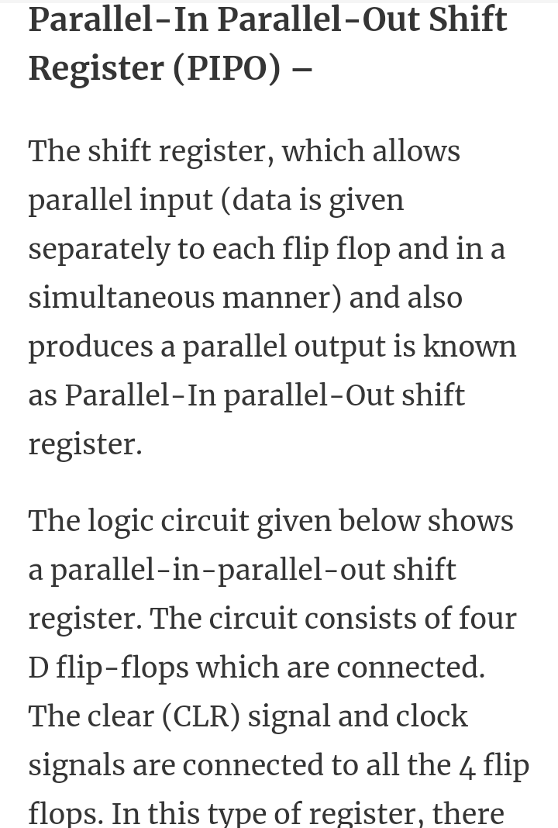
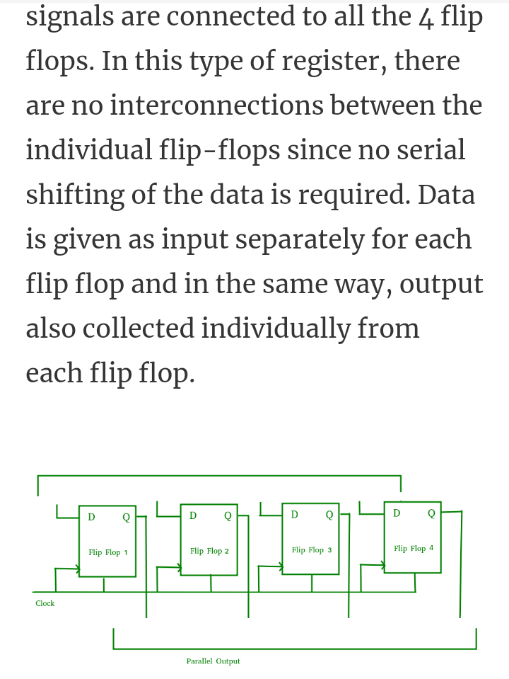
Digital Electronics and Computer organization BCA-II SEM Topic: Sequential Circuits

Slide 2
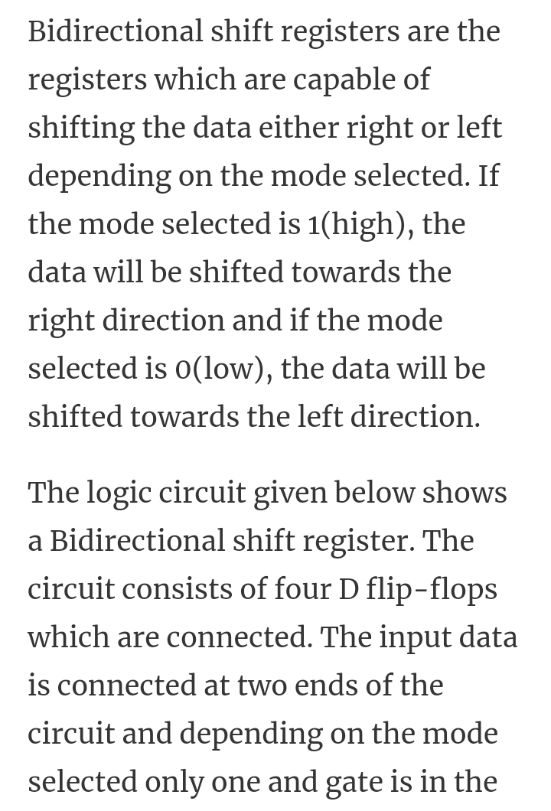
2

Slide 3
3

